Slide 1
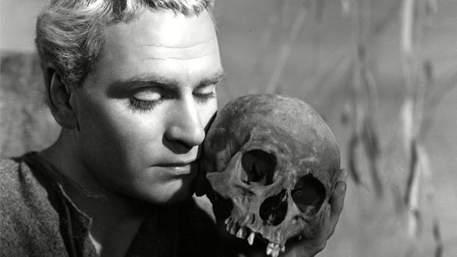
Hamlet
Prince of Denmark

Slide 2
Essential Questions
How do I evaluate ideas within and across texts?
How do I establish and use acceptable, meaningful criteria for selecting, evaluating, and citing texts and their evidence?
How do I know when I understand a critical lens or literary perspective? What do I do to comprehend? How do I know when I am confused? What might I do to clarify my confusion?
How do my own biases and beliefs influence how I make sense of texts in different ways?
Why and how does reading change my thinking?

Slide 3
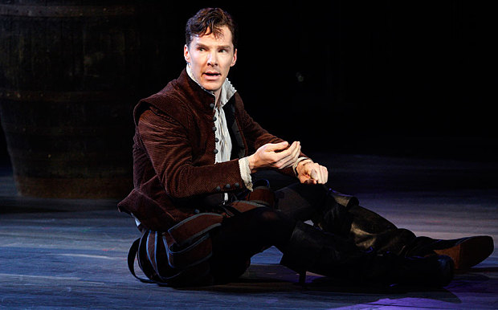
Hamlet

Slide 4
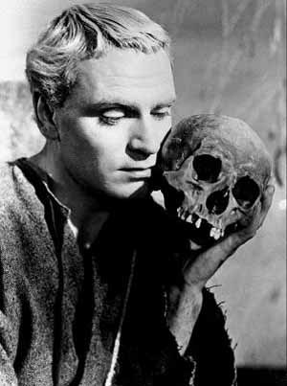
Agenda
Present Hamlet Unit
Critical lenses
Dialectical Journals
Socratic Seminar
Reading:
Participation grade (speaking & listening)
≥ 3 times substantial parts (up to 15 pts)
Volunteer basis, then Flashcards of DOOM
Essay Peer Edits/Workshops
https://www.youtube.com/watch?v=6_Y-tYrGBDc

Slide 5
Critical Lenses
Before we read Hamlet, you will be choosing a single critical lens from which to interpret and analyze the play.
Gender – Gender Roles in Elizabethan England
Marxist – Economics/Politics of Shakespeare’s time
Moral – Elizabethan Values, religion, etc.
Psychoanalytic – Further research into the lens itself
Historical (Theater, Education, Customs, Events, Language, Etc.)
Every Lens will require frontloaded research on the specific lens as it pertains to both the lens itself and Shakespeare’s time.

Slide 6
Journal Sample
Passage | Page | Interp
Claudius: “…But to preserver In obstinate condolement is a course of impious stubbornness. Tis unmanly grief.” | Act I, scene ii | Gender: Claudius uses a gender stereotype to belittle Hamlet by saying that his grief is “unmanly.” This suggests that real men do not have an emotional or familial connection, and this reinforces the idea that showing emotion is only something that women do. Hamlet’s father has only been dead for a month, so it is reasonable for him to still mourn.

Slide 7
Characters
In your Dialectical Journals, you will be emphasizing both your lens and a particular character as he/she develops and contributes to the story.
You are still responsible for general dialogue with the text as it applies to the following:

Slide 8
Look-Fors
Conflict
Murder
Betrayal
Insanity
Revenge
Setting
Elsinore (battlements)
Denmark
The mind
Dramatic irony
Imagery/Symbolism
See following slide for details and clarification
Soliloquy
Monologue
Concurrent plots

Slide 9
Act I, sc i and ii: Imagery and Symbols
Sun
Father, ruler, superego, male
Moon
Mother, lover, female, id
Light/Day
Consciousness, truth, knowledge, good, superego
Dark/Night
Unconsciousness, deceit, ignorance, evil, id
Time
Order, control, aging, regulation
Color
red=passion and blood, black=death, unconscious
Anatomy
head=logic, control
heart=feeling, passion
eyes= wisdom, truth, knowledge
hands=action, communication
blood=passion, violent death

Slide 10
A wee Summary

