Slide 2
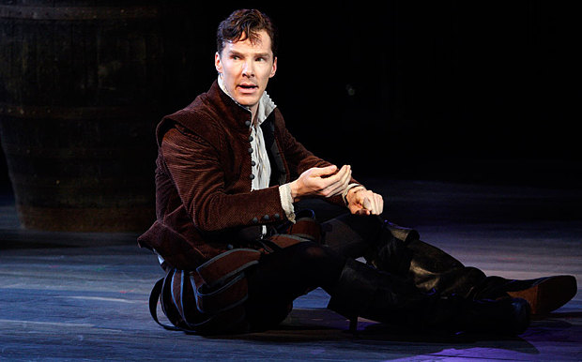
Hamlet

Slide 3
Essential Questions
How do I evaluate ideas within and across texts?
How do I establish and use acceptable, meaningful criteria for selecting, evaluating, and citing texts and their evidence?
How do I know when I understand a critical lens or literary perspective? What do I do to comprehend? How do I know when I am confused? What might I do to clarify my confusion?
How do my own biases and beliefs influence how I make sense of texts in different ways?
Why and how does reading change my thinking?

Slide 4
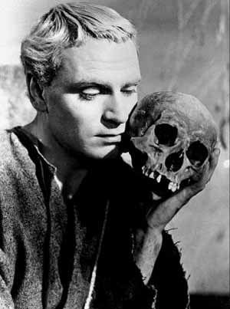
Agenda
Present Hamlet Unit
Critical lenses
Dialectical Journals
Socratic Seminar
Reading:
Participation grade (speaking & listening)
≥ 3 times substantial parts (up to 15 pts)
Volunteer basis, then Flashcards of DOOM
Essay Peer Edits/Workshops
https://www.youtube.com/watch?v=6_Y-tYrGBDc

Slide 5
Critical Lenses
Before we read Hamlet, you will be choosing a single critical lens from which to interpret and analyze the play.
Gender – Gender Roles in Elizabethan England
Marxist – Economics/Politics of Shakespeare’s time
Moral – Elizabethan Values, religion, etc.
Psychoanalytic – Further research into the lens itself
Historical (Theater, Education, Customs, Events, Language, Etc.)
Every Lens will require frontloaded research on the specific lens as it pertains to both the lens itself and Shakespeare’s time.

Slide 6
Journal Sample
Passage | Page | Interp
Claudius: “…But to preserver In obstinate condolement is a course of impious stubbornness. Tis unmanly grief.” | Act I, scene ii | Gender: Claudius uses a gender stereotype to belittle Hamlet by saying that his grief is “unmanly.” This suggests that real men do not have an emotional or familial connection, and this reinforces the idea that showing emotion is only something that women do. Hamlet’s father has only been dead for a month, so it is reasonable for him to still mourn.

Slide 7
Characters
In your Dialectical Journals, you will be emphasizing both your lens and a particular character as he/she develops and contributes to the story.
You are still responsible for general dialogue with the text as it applies to the following:

Slide 8
Look-Fors
Conflict
Murder
Betrayal
Insanity
Revenge
Setting
Elsinore (battlements)
Denmark
The mind
Dramatic irony
Imagery/Symbolism
See following slide for details and clarification
Soliloquy
Monologue
Concurrent plots

Slide 9
Act I, sc i and ii: Imagery and Symbols
Sun
Father, ruler, superego, male
Moon
Mother, lover, female, id
Light/Day
Consciousness, truth, knowledge, good, superego
Dark/Night
Unconsciousness, deceit, ignorance, evil, id
Time
Order, control, aging, regulation
Color
red=passion and blood, black=death, unconscious
Anatomy
head=logic, control
heart=feeling, passion
eyes= wisdom, truth, knowledge
hands=action, communication
blood=passion, violent death

Slide 10
A wee Summary

Slide 11
Deep Thoughts
Every job is a self-portrait of the person who did it. Autograph your work with excellence.

Slide 12
Do you know what day it is?
That’s right…
Its:
I’m President Business, and I approve this message.

Slide 13
Objectives
Research and gather information for contextual lens application to Hamlet
Use a dialectical journal technique to engage in the text to identify themes, characterization, and interpretations.
Apply critical lenses to Hamlet to explore meanings within and beyond the text

Slide 14
Agenda
Warm-up!
Shakespeare’s context (10 min)
Research Workshop (30 min)
Begin Act 1 of Hamlet (50 min)
Recap Look-fors
Dialectical Journals
Setting the scene

Slide 15
In your notes:
Discuss what you know about Shakespeare, his life, accomplishments, style, etc.
Discuss what you know about Elizabethan Theater and culture. Consider training, stagecraft, political context, etc.

Slide 16
Lens Research
On the same notes:
Take the next 30 minutes or so to gather what information you can to help you interpret your lens.
Gender – Gender Roles in Elizabethan England
Marxist – Economics/Politics of Shakespeare’s time
Moral – Elizabethan Values, religion, etc.
Psychoanalytic – Further research into the lens itself
Historical (Theater, Education, Customs, Events, Language, Etc.)
You may work in small groups, but please be sure to gather your own notes for applying your critical lens.

Slide 17
Resources for info
http://www.bardweb.net/
http://www.shakespeareinamericancommunities.org/
http://elizabethan.org/compendium/
http://www.shakespeare-online.com/
http://www.elizabethan-era.org.uk/

Slide 18
Begin Act 1
What we’re looking for:
Context/mood/Exposition
Themes (Revenge, Surveillance, Indecisions, Choice, etc.)
Key passages (why?)
Plot/character development
Language play, puns, etc.
Symbolism, Dramatic Irony, Conflict, Setting
Questions
Lens application

